Slide 1
Center for Behavioral Technologies
Development & Application of DBT:
Practical Strategies for Practical Therapists
Marsha M. Linehan, Ph.D., Zen Roshi
Notes:
Copyright 2011 by Marsha M. Linehan
1

Slide 2
Conflicts of Interest
Receives grant funding from the National Institute of Mental Health (NIMH) for DBT research and development
Receives training and consultation fees from Behavioral Tech, LLC.
Receives compensation as owner of Behavioral Tech Research, Inc.
Receives royalties from sale of DBT books

Slide 3
Where DBT Started: 1980
Patients: high risk for SUICIDE with multiple suicide attempts/self-injuries
Funding: NIMH treatment development grant for suicidal behavior
Starting point: behavior therapy

Slide 4
DBT Model
Suicidal Behavior =
Problem Solving
(for the client)
and
A Problem
(for the therapist)

Slide 5
I needed a Comprehensive Treatment that would
Improve Motivation
Enhance Capabilities
Enhance Generalization
Manage and/or Provide
Environmental Intervention
Maintain Skills and Motivation of Treatment Providers

Slide 6
Immediate Problems to Solve
Extreme sensitivity to rejection and invalidation made a change focused treatment untenable. (I’m the cause?)
Extreme suffering made an acceptance based approach also untenable. (Aren’t you going to help me?)

Slide 7
I Needed New Therapist Strategies
Synthesis of:
Technology of Change and
Technology of ACCEPTANCE
Spaciousness of Mind
To “dance” with movement, speed and flow
Radical ACCEPTANCE of:
Client Slow and Episodic Rate of Progress
Risk of Suicide
Humility
To see the transactional nature of the enterprise
Notes:
Copyright 2006 by Marsha M. Linehan
7
Copyright by Marsha M. Linehan
7

Slide 8
Solution Was to Apply A Dialectical Approach Balancing
Change
Strategies
Acceptance
Strategies
Dialectics
Notes:
Copyright 2008 by Marsha M. Linehan
8

Slide 9
Modularity of DBT STRATEGIES
Behavioral Assessment
Pay Attention
Reflect Back accurately
Dialectical Strategies
Contingency Management Procedures
Change Strategies
Strategy Type
Acceptance Strategies
Accurate reading of the unsaid
Problem solving
Core Strategies
Validation
Cognitive Modification Procedures
Understanding the causes
Irreverence
Communication
Reciprocally
Acknowledge the inherently valid
Skills Training Procedures
Consultation to Patient
Management of Environment
Environmental Intervention
With equality and Authenticity
Exposure Procedures

Slide 10
Immediate Problems to Solve
Low distress tolerance and frequent crises and high arousal made sustained work on change very difficult.

Slide 11
I needed New Client Targets
Radical ACCEPTANCE of:
One set of problems to work on another set
The Past, The Present
Limitations on the Future
Distress Tolerance:
Ability to tolerate distress without impulsively moving to suicide or other destructive behavior
Experience of one’s own:
Connection with others and the universe
Essential “goodness”
Essential validity
Notes:
Copyright 2006 by Marsha M. Linehan
11
Copyright by Marsha M. Linehan
11

Slide 12
Solution Was to Develop A Dialectical Approach, Teaching
Change
Skills
Acceptance
Skills
Dialectics
Notes:
Copyright 2008 by Marsha M. Linehan
12

Slide 13
Change Skills Where they came from
Social Psychology and
evidence based behavior therapy interventions

Slide 14
Acceptance Skills Where they came from
Contemplative prayer practices
Soto Zen at Shasta Abby (California)
Sanbo Kyodan Zen, combining Soto and Rinzai Zen at Benedikushof (Germany) Willigis Jaeger Benedictine Zen Master

Slide 15
Example Change Skills
Interpersonal Skills
Emotion Regulation Skills
Distress Tolerance Skills
Notes:
Copyright 2004 by Marsha M. Linehan
15

Slide 16
Example Mindfulness Skills
Wise Mind
Observing
Describing
Participating
Non-judgmentally
One-mindfully
Effectively
Radical Acceptance
Willingness
Turning the Mind
Mindfulness “Whats”
Mindfulness “Hows”
Reality Acceptance
Notes:
Copyright 2004 by Marsha M. Linehan
16

Slide 17
Immediate Problems to Solve
4. Ever changing clinical presentation together with frequent crises resulted in confused therapists and a chaotic therapy

Slide 18
Percent DSM Diagnoses:
BPD Chronically Suicidal Patients
Diagnosis Lifetime Current
Major depression 96.7% 75.0%
Dysthymic disorder N/A 14.3%
Substance abuse 15.2% 5.4%
Substance dependence 56.5% 26.1%
PTSD 56.5% 51.1%
Social phobia 21.7% 16.3%
Panic disorder 52.2% 40.2%
OCD 23.9% 19.8%
Eating disorder 41.3% 23.9%
Linehan et al., 2006
Notes:
Copyright 2008 by Marsha M. Linehan
18

Slide 19
Adolescent DSM Diagnoses:
Suicidal Patients
Diagnosis Lifetime
Greater than 3 disorders 60.6%
Major depression 53.8%
Alcohol abuse 43.2%
Conduct disorder 42.6%
Substance abuse 32.9%
Simple phobia 30.8%
Social phobia 28.8%
PTSD 27.1%
Knock & Kessler, 2006
Notes:
Copyright 2008 by Marsha M. Linehan
19

Slide 20
Solution Was to Provide A Dialectical Balance
Protocol-based Agenda
Individualized Target-based Agenda
Dialectics
Notes:
Copyright 2008 by Marsha M. Linehan
20

Slide 21
Immediate Problems to Solve
5. Need for multiple interventions and a host of behavioral skills could easily lead to memory overload and confusion about what to do when.

Slide 22
A Hierarchical Approach
Higher Importance
Higher Importance
Life Threatening Behaviors
1: Behavior Dyscontrol
Therapy Interfering Behaviors
2: Quiet Desperation
(Serious) Quality of Life Interfering Behaviors
3: Problems in Living
4: Incompleteness
Skills Deficits
Lower Importance
Lower Importance

Slide 23
The Immediate Problem to Solve
6. Treating individuals at chronic high suicide risk is scary, often leads to treatment based on fear of being sued and often leads to burnout.
Standard of care has no data that it is effective.
(Hospitalization has no data that it reduces suicide)
There was no evidence-based treatment to fall back on.
Notes:
Copyright 1997 by Marsha M. Linehan
23

Slide 24
Solution Was to Provide A Dialectical Balance
DBT Risk Assessment and Management Protocol
Standard of Care
Dialectics
Notes:
Copyright 2008 by Marsha M. Linehan
24

Slide 25
Linehan Suicide Safety Net (LSSN) based on the DBT Risk Assessment and Management Protocol ( LRAMP )

Slide 26
The Problem Further
7. Therapist emotion dysregulation often led to excessive fear, anger and hostility resulting in attempts to control the patient, rejection and burnout.
8. Excessive empathy leading to falling into the pool of despair with the client and abandoning therapy

Slide 27
Solution Was to Provide A Dialectical Balance
Client
Therapist
Team
Notes:
Copyright 2008 by Marsha M. Linehan
27

Slide 28
DBT Staff Hierarchy
Client
Individual Therapist/
Case Manager
Case Manager
Medication Prescriber
Skills Trainer(s)
Team Leader

Slide 29
Next Problem to Solve
9. Getting an NIMH grant required at least one mental disorder as an inclusion criteria My choices were BPD or Depression as both were related to suicide I chose BPD
Notes:
Copyright 2006 by Marsha M. Linehan
29

Slide 30
Solution Was to Provide A Dialectical Balance
Diagnosis
Problem Behavior
Mechanisms of Disorder
Notes:
Copyright 2008 by Marsha M. Linehan
30

Slide 31
Next Problem to Solve
10. Develop a model of BPD
Capable of guiding effective therapy
Non-pejorative, engendering compassion
Compatible with current research data

Slide 32
BPD is a Pervasive Disorder of the Emotion Regulation System
BPD criterion behaviors function to regulate emotions or are a natural consequence of emotion dysregulation
Notes:
32
KEY WORD IS PERVASIVE…across time, across people, across contexts.

Slide 33
Solution Further Was to Provide A Dialectical Model of Pathogenesis
Biological Regulation Disorder
Invalidating
Social Environment
Transaction
Notes:
33
KEY WORD IS PERVASIVE…across time, across people, across contexts.

Slide 34
Next Problem to Solve
11. Does DBT Only Work only because the Linehan is an expert therapists”?
Notes:
Now, one of the major critiques that Marsha continually received from non-behavioral therapists was that DBT only treated clients’ superficial symptoms but didn’t really get to the core of the problem. Basically, that behavioral therapy might get rid of the external behaviors that are problems, but the patient’s internalized negative self-view would remain. So after a while, Marsha got tired of hearing this critique and decided to do some research on it. Problem was, she didn’t know how the heck to measure an internalized negative self-view. So she called up her non-behavioral friends and asked for a measure that would assess all these things they thought she wasn’t treating. So, finally she got her hands on Lorna Benjamen’s Structural Analysis of Social Behavior, which measured among other things the client’s self-view, called an introject.
So she got the tools to test it and the question was … were they right?

Slide 35
DBT compared to Expert Community Therapy
Suicide attempts: 50%
ER visits for suicidality: 53%
Inpt. admits for suicidality: 73%
All remain 50% lower during follow-up
Notes:
We found that compared to patients receiving therapy from expert, non-behavioral psychologists, those in DBT had approximately 50% fewer suicide attempts and ER visits for suicidality and over 70% fewer inpatient admissions for suicidality. This difference remained at a follow up assessment, where patients who had received DBT continued to have 50% fewer suicide attempts and hospital visits.

Slide 36
Does DBT Only Treat “BPD?
Data indicated it was useful for other disorders but
Stigma of DBT kept people out of DBT

Slide 37
Examples DBT for Substance Abuse DBT for Heroin Addiction DBT for Adolescents DBT for Native Americans DBT for Friends and Families

Slide 38
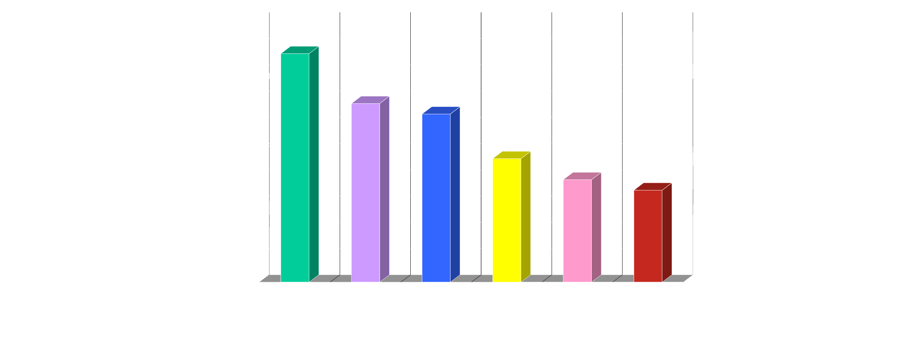
Outcomes for Axis I Disorders:
87%
68%
64%
47%
39%
35%
(Harned, Chapman, Dexter-Mazza, Murray, Comtois, & Linehan, 2008)
Notes:
38
38
Copyright 2010 by Melanie S. Harned

Slide 39
Next Problem to Solve
12. Standard DBT is very good at treating disorders with “out-of-control” behaviors
DBT anxiety disorder outcomes were not as good as behavioral treatments treating anxiety disorders in standard practice

Slide 40
Next problem further
13. High risk individuals are sometimes not able to tolerate the stress of exposure-based treatments
I had scared many out of providing exposure treat by pointing this out.

Slide 41
Solution Was to Combine
DBT Prolonged Exposure Protocol
DBT Contingency Management
EB DBT
Melanie Harned
Notes:
41
KEY WORD IS PERVASIVE…across time, across people, across contexts.

Slide 42
Are skills a key component in DBT treatment?
Notes:
One of the key aspects of DBT therapy is the inclusion of skills training. Skillful behaviors are typically taught and coached in a group therapy setting, which my colleague Amanda is going to tell you about in detail later. It terms of treatment development it was important for us to understand the impact of skills training on patient outcomes to determine if teaching skillful behaviors was a necessary and/or sufficient component of treatment.

Slide 43
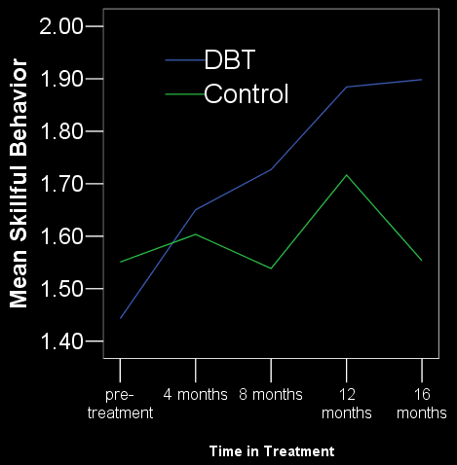
Do Clients use skills?
(Neacsiu, Rizvi, & Linehan, 2010)
Notes:
Copyright 2004 by Marsha M. Linehan
43
This graph shows increasing use of skills. The red line shows DBT clients, are continually increasing their use of skillful behavior and maintain that high level of use even at 4 months follow-up. The control, in blue, do have some increases, but these are lost at follow-up.
Ok, so DBT clients are using the skills!

Slide 44
Do Skills Effect Outcomes
Use of DBT skillful behaviors partially accounts for reductions in
difficulties in emotion regulation.
Improved interpersonal relationships
Reduction in suicidal behaviors
Skills alone given to waiting list for DBT
Reduce suicide attempts Shelly McMain

Slide 45
To Summarize Outcomes DBT:
Reduces:
Suicide attempts
Non-Suicidal Self Injury (NSSI)
Depression, Hopelessness
Anger, Substance dependence
Impulsiveness, is a treatment shown effective for BPD
Increases:
Adjustment (general & social)
Positive self-esteem (introject)
(See Lieb et al. 2004)
Notes:
Lieb, K., Zanarini, M.C., Schmahl, C., Linehan, M.M., & Bohus, M. (2004). Borderline personality disorder. Lancet, 364, 453-461.
We’ve found, though, that DBT is not only effect at reducing suicide attempts and non-suicidal self-injury, but also reduces a number of other problem behaviors, which are listed here. And also increases positive adjustment and self-esteem.
So for me, I’m pretty sold at this point that, no question, DBT is effective and fabulous … but not everyone is as easily convinced as me, and I’ve got 25 more minutes before my time runs out. So, we’re going to dig a little deeper into the research. Now, once we got some evidence that DBT worked, we wanted to start understanding why and how it worked, and wonderfully enough there were plenty of critics to point out possible explanations that we could then test.

Slide 46
Next Problem to Solve
14. Patient populations differ due to differential diagnosis and problems, differential context and environment and also due to different cultures

Slide 47
Solution Was to Stretch DBT without Changing it to non-DBT
Modify Only Where Absolutely Necessary
Keep Everything Else
EB DBT
Notes:
47
KEY WORD IS PERVASIVE…across time, across people, across contexts.

Slide 48
Solution is to Increase DBT Research:
Axis I/Low Risk Skills Training Alone
BPD/High Risk
Individual + Skills
EB DBT
Individual
Notes:
48

Slide 49
Next Problem to Solve
15. DBT as treatment for mental disorders only
Experience indicated it could be useful for general public, i.e., those without diagnosed mental disorders
Stigma of mental disorder kept people out of DBT

Slide 50
Solution is to Further DBT Research:
DBT focused on disorder
DBT Skills for friends, family and schools
EB DBT
Individual
Notes:
50

Slide 51
Where are we Now? How Well Does DBT Reduce Suicidal Behaviors?
Notes:
Which suggests that the gains made in DBT cannot be solely explained [click] by the use of expert psychotherapy.

Slide 52
Suicidal & Intentional Self-injurious
Acts By Condition and Time
Mean # of Acts
(Linehan et al., 1991, 1999, 2002, 2006)
Notes:
As Erin told you about earlier, DBT was original designed as a treatment for chronically suicidal patients, so it only makes sense to start by looking at how DBT measures up on these outcomes. So here you see a comparison of the number of suicidal and intentional self-injurious acts committed by patients in a 1 year treatment, with the green bars representing DBT patients and the yellow are control patients.
Focusing just on the green bars, [click] DBT patients are consistently showing reduced numbers of suicide and self-injury across the treatment year. And compared to control patients, [click] DBT patients committed far fewer total acts, and that pattern, though less dramatic, [click] was maintained at follow up.

Slide 53
Is DBT cost effective?
Cost for DBT is approximately 50% LOWER than treatment as usual
DBT also has significantly FEWER:
Inpatient days
Deliberate self-injury
Emergency medical visits
Therapy drop out
Notes:
… In general, the news is good. DBT costs approximately 50% less than treatment as usual, and patients receiving DBT had significantly fewer inpatient days, had fewer and less severe acts of deliberate self-injury, fewer ER visits, and less therapy drop out than treatment as usual.

Slide 54
Is DBT cost effective?
Yes!
Notes:
All in all, compared to treatment as usual and other more specific therapies, DBT seems to win out specifically due to reductions in hospitalizations and inpatient treatment and the ability to be effective in a single treatment year.

Slide 55
Where are we going now ?

Slide 56
What Is Needed NOW
1. More Effective Dissemination of DBT
2. Research on treatment of suicidality
3 Training in suicide research methods
4. Research to Answering the question “Is sending highly suicidal people to ED and hospitals iatrogenic rather than therapeutic?”
5. Stop fragilizing our graduate students and train them for high suicide risk cases
6. Address IRB & University fears

Slide 57
What Is Needed?
1. More effective dissemination of DBT
Computerized DBT Skills
Computerized Psychotherapy
We can do this

Slide 58
What Is Needed?
2. A more robust field of suicide researchers
University of Washington
Strategic planning meetings
Let's try again

Slide 59
What is needed
3. Answering the question “Is sending highly suicidal people to ED and hospitals iatrogenic rather than therapeutic?”
Conduct RCTs comparing inpatient with outpatient for high suicide risk:

Slide 60
What is needed
4. Stop fragilizing our graduate students and train them for high suicide risk cases
Develop high risk for suicide practicums
Disseminate effective programs
Such as the
University of Washington Program
Treating high risk adolescents, adults and
friends and families

Slide 61
What is needed
4. Address IRB & University fears
Develop Instructions on how to get Through an IRB
Helen McGough and I are writing a book on how the two of us (She as head of the IRB), got me through every study I did.
On this topic, can I tell you how wonderful the
UW police have been to us?
Fabulous, Fabulous!!!

Slide 62
Real Change IS POSSIBLE
We can do this if we work together

